Slide 1
Human Resources Issues
Chapter 10
CS449-Professioal Issues in Information Technology
Course Instructor: Engr. Saeeda Kanwal Khilji

Slide 2
Chapter Outcome
The purpose of this chapter is to explain some of the most important human resources issues that affect companies in the IT sector. After studying it, you should:
appreciate the complexity of the law in this area;
understand the constraints under which management and human resources staff act;
understand why and to what extent managers need to be aware of general human resources issues.

Slide 3
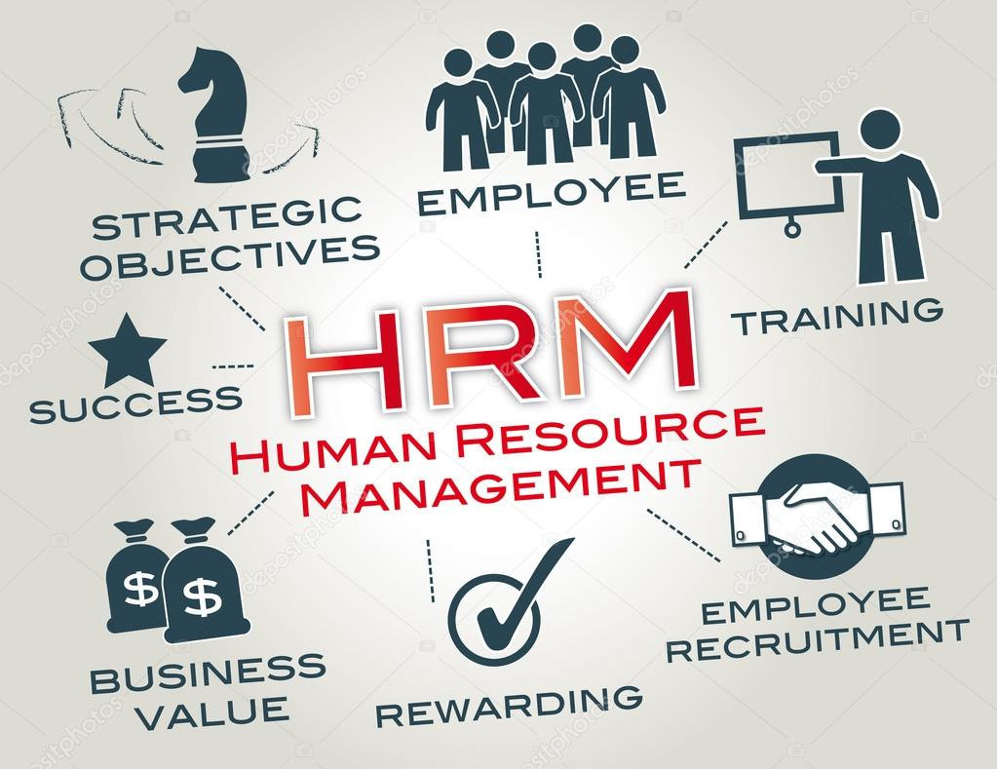
Human Resource Management (HRM)

Slide 4
Human Resource Management (HRM)
Human Resource Management (HRM) is the term used to describe formal systems devised for the management of people within an organization.
OR
Human resources is used to describe both the people who work for a company or organization and the department responsible for managing resources related to employees.

Slide 5
Aim of HRM
The term ‘human resources’ emphasizes the fact that the people who work for an organization are an indispensable part of the organization’s resources and the most important one.
For this reason, the organization will try to ensure that it always has appropriately skilled, qualified & experienced staff that it needs.
This must be done without wasteful over-staffing and within the constraints of what is lawful.

Slide 6
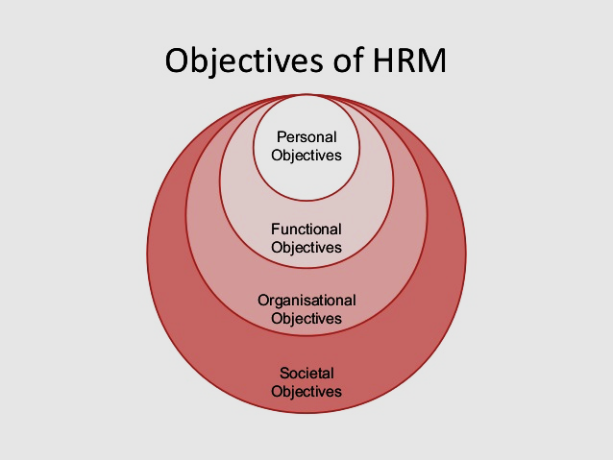
Aim of HRM

Slide 7
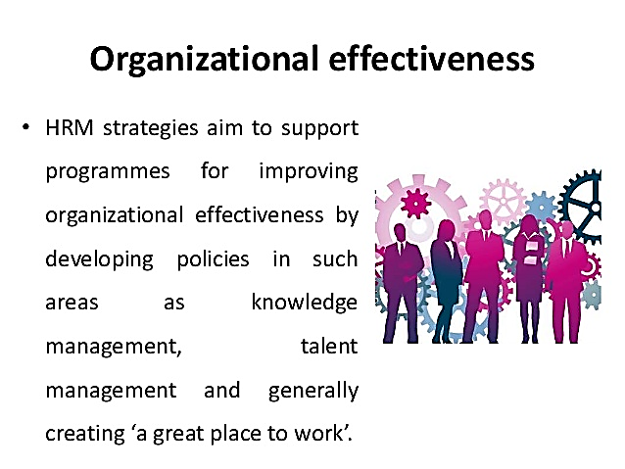
Aim of HRM

Slide 8
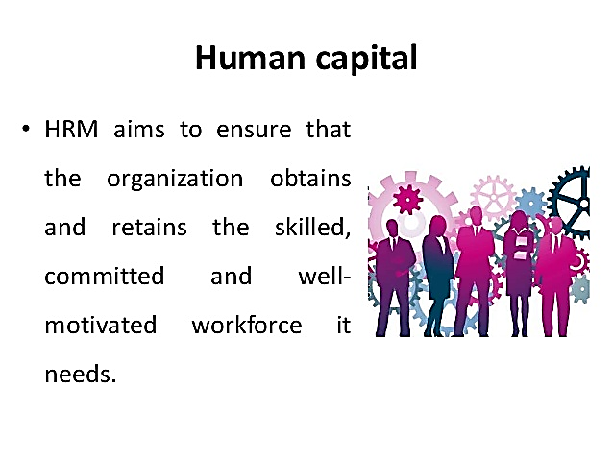
Aim of HRM

Slide 9
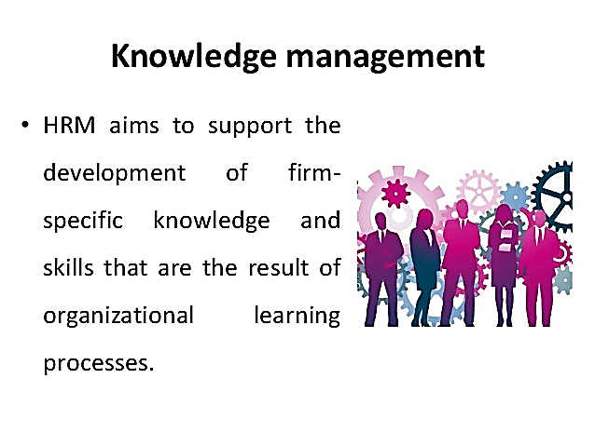
Aim of HRM

Slide 10
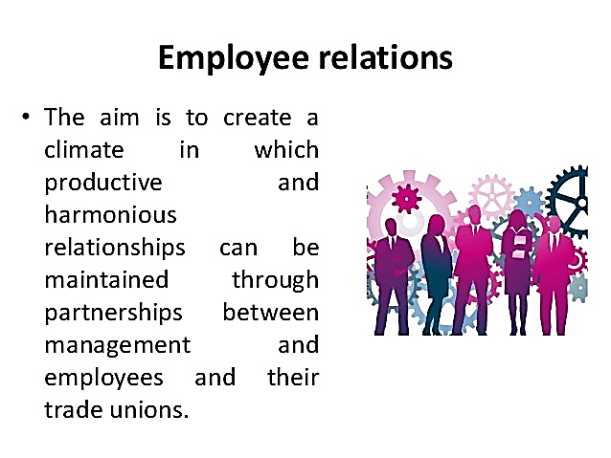
Aim of HRM

Slide 11
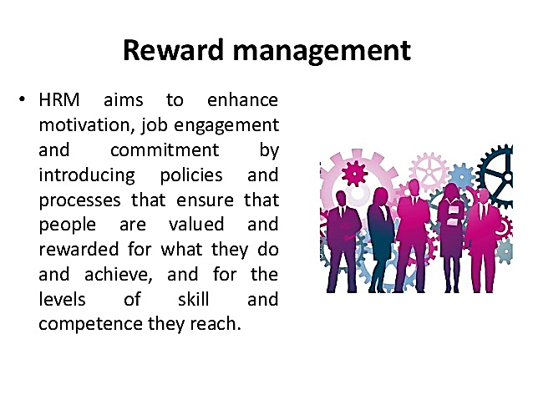
Aim of HRM

Slide 12
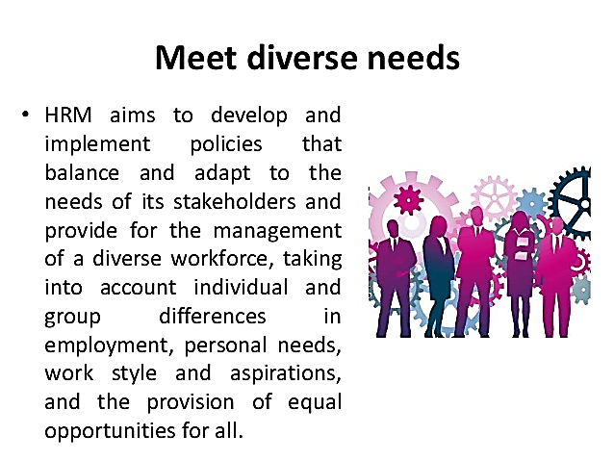
Aim of HRM

Slide 13
Aim of HRM…
The cost of recruiting new staff is high and the loss of continuity when staff leave can also be very expensive.
Accordingly the organization will want to keep staff turnover low.
Many organizations want to behave as a ‘good’ employer and will therefore try to follow the best of current employment practice.

Slide 14
Aim of HRM…
Any organization that employs staff will be faced with the need to handle administrative issues relating to their employment.
As the number of employees grow, a full-time personnel officer or human resources manager will be required.
However, managers cannot hand over all responsibility for personnel matters to specialists.
This is true specially in the IT industry, where staff have high expectations and staff turnover is particularly high.

Slide 15
Recruitment and selection…
Human resources managers often make a distinction between the two terms recruitment and selection.
Recruitment is the process of soliciting applications for jobs. It is often handled partly or entirely by consultants.
Selection is the process of selecting from the available applicants.
While recruitment consultants may screen the initial applications, they don’t usually do the final selection.

Slide 16
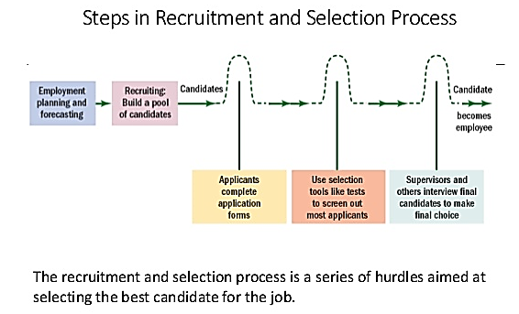
Recruitment and selection…

Slide 17
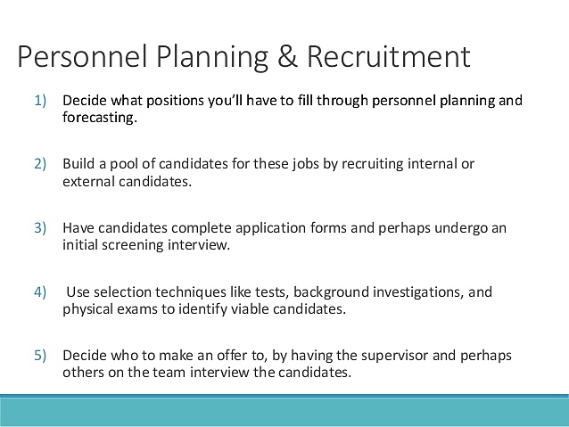

Slide 18
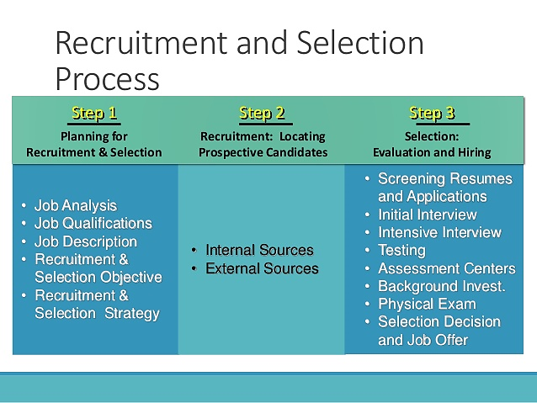

Slide 19
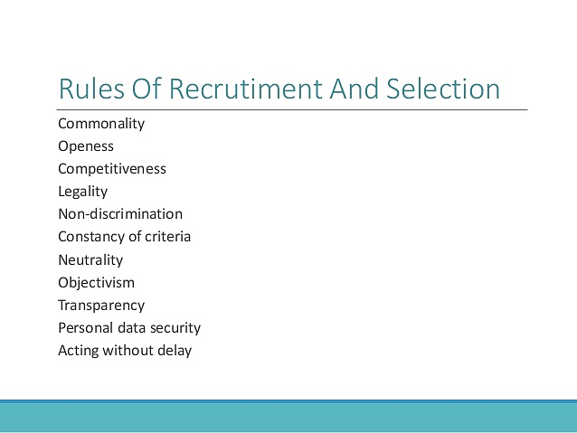

Slide 20
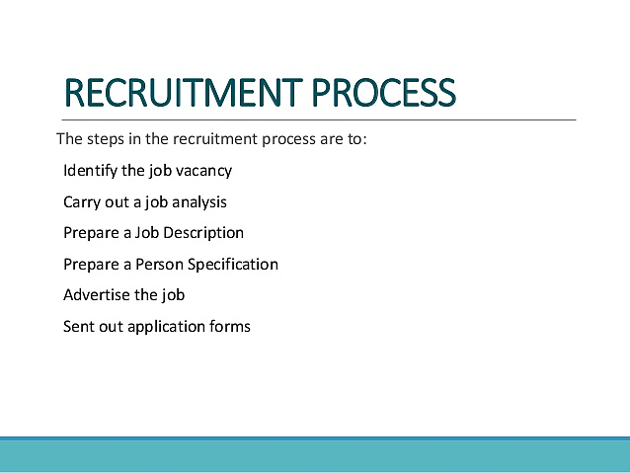

Slide 21
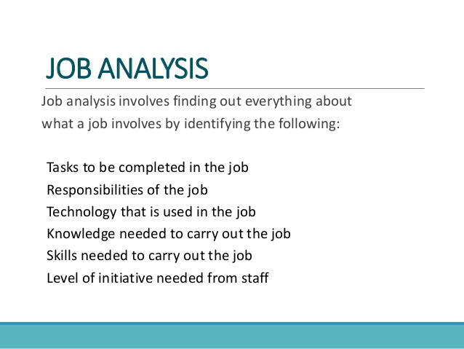

Slide 22
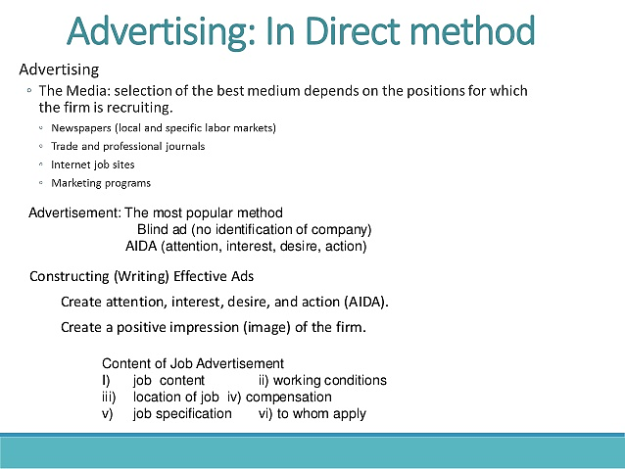

Slide 23
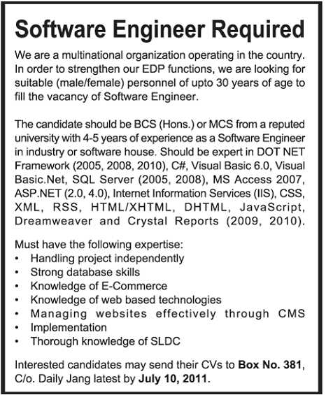

BLIND AD…

Slide 24

EFFECTIVE AD…

Slide 25
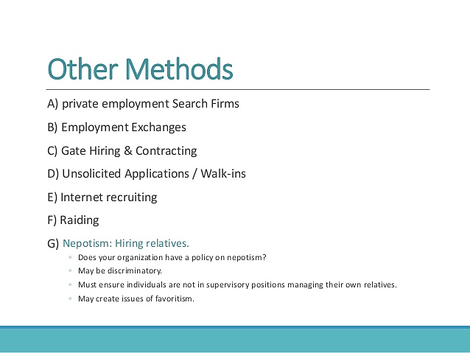

Slide 26
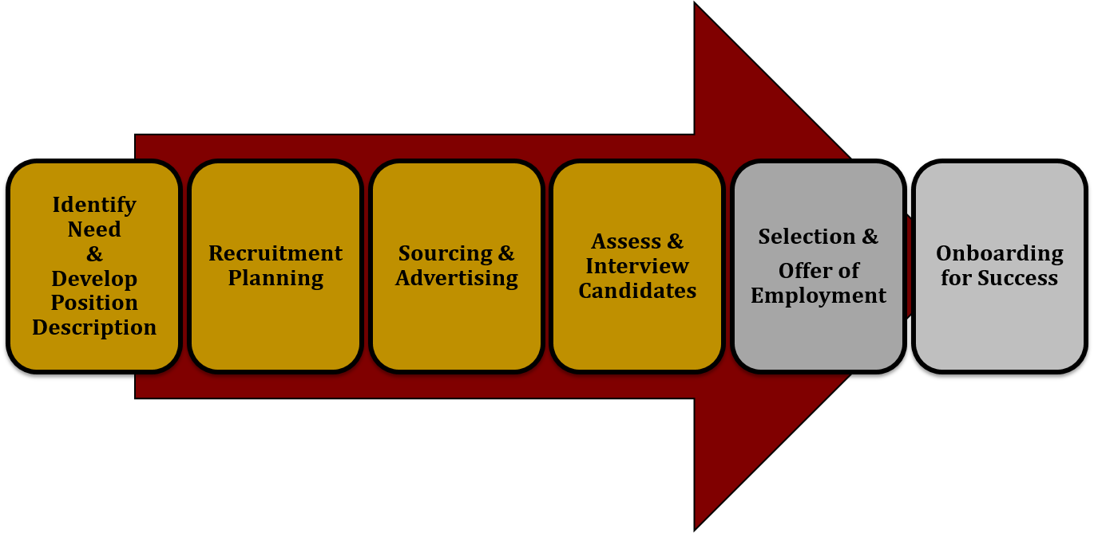
Recruitment

Slide 27
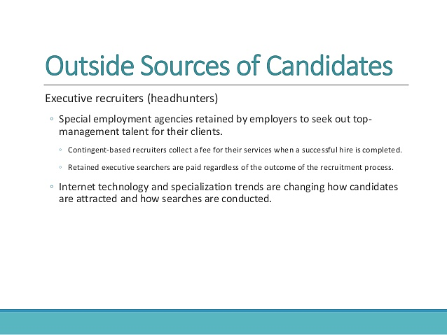

Slide 28
Selection techniques
Selection is made mostly by the employer, although a member of the recruitment agency staff may also be used to advise.
Following are some of the selection techniques used in making professional appointments:
One-to-one interviews with several senior managers and technical staff
Interview by a panel
Assessment of references
Aptitude tests
Situational assessment
Task assessment

Slide 29
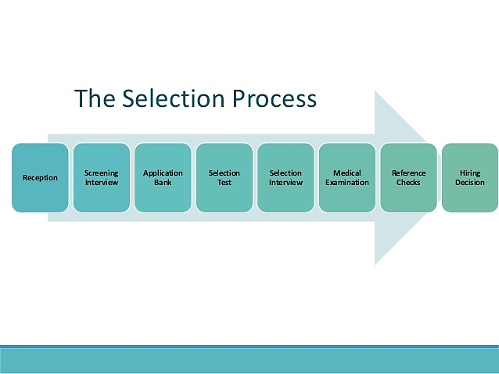

Slide 30
Staff training and development
Staff training and development are of particular importance in high technology companies, where failure in this respect can threaten the company’s reputation.
It is unfortunate that, when money is tight, it is often the first thing to be cut.
Companies Identify training & development needs during appraisals/reviews. They give staff a guarantee of at least 10 days training a year.
This training in specific skills is only useful if they can be exercised straightaway
Development/education has long term impact
Can be a good way of keeping staff

Slide 31
Remuneration policies
One of the major sources of staff dissatisfaction in organizations is perceived disparities in remuneration, (Remuneration means salaries + Benefits).
A good remuneration policy aims are:
Staff retention (or controlled loss!)
Consistency of treatment within the company, to avoid discontent
Comparability with conditions outside the company.

Slide 32
Appraisal schemes
It is astonishing that people working for years in a professional job without anyone, colleague or superior, giving them any indication of how well they are doing the job or how they might improve.
This was commonly the case for school teachers, university lecturers, many civil servants, and managers in commercial and industrial organizations.
It is still true of many doctors, solicitors, architects, etc.
Till recently, there were no procedures or regulations that ensured that there was any such feedback.

Slide 33
Appraisal schemes….
It is the job of the human resources management to design procedures to avoid this undesirable situation.
Appraisal schemes are the usual formal way of doing this. They derive from the idea of Management by Objectives (MBO).
A good appraisal process provides an effective way of fulfilling the requirements of a professional body and It must:
Set agreed objectives
Monitor and review performance against objectives
Set new or modified objectives
Assess training needs
Discuss career ambitions

Slide 34
Objectives | Plan (Methodology) | Time(1) | Resources | Assessment
By the end of the lesson pupils should be able to: --Discuss the manner in which characters are introduced by the playwright - Present Information and point of views clearly and appropriately in context of the story. | INTRODUCTION: Introduction to the lesson by recapping the previous read Scene. Main Activity: Speaking and Listening Opportunity -Involving the whole class by asking them to discuss in groups, How the novel influences the flow of the story. -Analysing and Discussing the manner in which characters are introduced by the writer. -One by one each group Presenting Information and point of views clearly and appropriately in context to the novel to their class mates Analysing through Writing Students will be asked to individually plot and encapsulate the new characters by making a Venn diagram for testing their inferring skills. (Aunt Sponge and Aunt Spiker) WRAP UP: Teacher to wrap up by answering queries that students have | 5 mins 20 mins 20 mins 20 mins 10 mins | Novel (James and the Giant Peach) | Students will be assessed on their ability to: - Discuss the manner in which characters are introduced. - Analyse the characters in terms of Dialogue, nature etc. - Present Information and point of views clearly and appropriately.
Evaluation of Student Learning: What did the children learn in this lesson? ________________________________________________________________________________________________________________________________________________________________ What did they actually do? OR What were they not able to do / understand? ________________________________________________________________________________________________________________________________________________________________________________________________________________________ |  | Evaluation of Teaching: If you were to teach this lesson again, what would you do differently? (Comment on any ONE aspect of your teaching and planning) ________________________________________________________________________________________________________________________________________________________________________________________________________________________________________________________________________________________________________________________________________________________________________________________________________

Slide 35
Failure of appraisal schemes
However great, appraisal schemes usually fail due to the following reasons:
There’s always something more urgent than the appraisal interview.
Seen as ineffective – good appraisal reports don’t lead to anything; no one takes any notice of what was agreed.
Appraisers who don’t know anything about the appraiser's work.
More emphasis on the measurable.

Slide 36
Redundancy and dismissal
Redundancy occurs when staff are fired because there is insufficient work for them. They may be eligible for compensation.
Dismissal means firing staff because there work is unsatisfactory.
In both cases it is important to have procedures and to follow them, in order to avoid litigation/legal action.
The HRM department is responsible for setting up these procedures and advising the company on how to use them.

Slide 37
Dismissal Procedures
Following are the dismissal procedures:
employer must give employee a written statement of why dismissal is being considered;
employer must arrange a meeting at which both sides can state their case;
employer must inform employee of decision, in writing;
employee must have right to appeal to a more senior manager, where this is practicable.
Any dismissal that does not follow or incorporate this procedure will automatically be considered unfair.
Simply following the procedure does not, however, automatically make the dismissal fair.

Slide 38
Contracts of Employment
According to Law, every employee must have a contract of employment.
What this means is that the agreement between an employee and their employer can be enforced in a court of law.
A good contract of employment should be written in terms that are easily understood and should avoid legal jargon.
Prospective employees should not need to consult a lawyer in order to understand it. They should, however, read it carefully before signing it.

Slide 39
Human resource planning
If the human resources department wants to ensure that the organization always has the staff available it needs, it must be able to forecast the needs some time ahead.
This is extremely difficult, particularly in software companies.
From software houses through banking, manufacturing and retailing the uncertainty is always present, but it can be reduced to possibly predict staff needs much more precisely.

Slide 40
Human resource planning…
In a software house, there are three inputs to the human resource planning process:
Human resource plans from existing projects, showing how many staff of each grade and with which specialized skills will be required in each of the following months.
Sales forecasts: These are subject both to the unexpected behavior of potential clients and the judgement, good or otherwise, of the sales staff.
Forecasts of the likely staff losses in the coming months: In the software business this depends very much on the buoyancy of the market for software developers.

Slide 41
Human resource planning…
From these inputs, it can be predicted as to how many staff will be required each month, and how many will be available.
In practice, human resource prediction in project-based companies never works very well and there are good statistical reasons why it never will.
If we are summing 1,000 weighted predictions, the uncertainty in the sum will be quite small, even though the uncertainty in each prediction may be quite large; this is called the Law of Large Numbers.

Slide 42
Job Design
Setting up an organizational structure implies designing jobs. As soon as a one-person organization becomes a two-person organization, it has to decide who does what; in other words it has to design jobs.
In project-based organizations, jobs get designed when the project team is set up and when the project plan is produced.
The jobs are temporary – they last only as long as the project – and the technical nature of the project determines exactly what tasks the jobs have to cover.

Slide 43
Job Design…
The job design in IT companies is done within an established framework:
a project-based organization will have procedures in which project teams are to be structured
Such procedures may mandate the use of chief programmer teams in certain circumstances, or specify the maximum span of control and the responsibilities of team leaders, and project quality assurance (QA) staff in a hierarchically organized project.
The tasks to be carried out will be defined by the development methodology that the company uses.

Slide 44
Job Design…
In many large organizations structured along bureaucratic lines, job specialization leads to very narrow and tightly defined jobs.
As a result, the people carrying out those jobs find them dull and unsatisfying. This in turn leads to poor performance and high turnover.
In an effort to alleviate this problem, companies have tried three different ways to provide more interesting and satisfying jobs: job rotation, job enlargement, and job enrichment.

Slide 45
Scenario
Job rotation is rotating staff through series of jobs, is the most obvious way of preventing employees from becoming bored with a very narrow and specialized task.
Consider handling of creditor’s invoices in a large accounts department with a very specialized regime.
An analysis of the process might identify the following tasks, which then might be allocated to the individuals named: Freda, Gareth, John, Peter, Julie.

Slide 46
Tasks
1. Receive incoming invoice and match to purchase order (Freda)
2. Confirm price calculations and despatch to receiving Department for confirmation that goods or services have been received (Gareth)
3. Receive confirmation from department and pass for payment (John)
4. Produce payment (Peter)
5. Handle queries arising at any of the above stages (Julie)

Slide 47
Job rotation
Freda, Gareth, John and Peter move round every week.
It gives staff a greater variety.
It gives department greater resilience or elasticity in the case of sickness, holiday or resignation.

Slide 48
Job enlargement
Job enlargement means each of these members does tasks 1 to 4 for a particular group of invoices (e.g. particular suppliers or particular divisions).
It adds variety and interest, and may increase pride in job.
It may not be consistent with separation of responsibilities in financial matters.

Slide 49
Job enrichment
Job enrichment means adding more responsibilities, to say, Julie’s job.
It is very effective for some staff members.
Others may not want too much responsibility.

Slide 50


Slide 51
